Slide 1

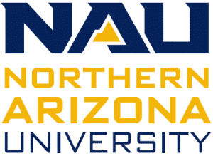
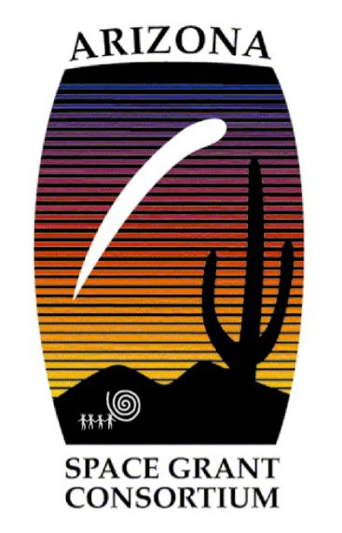
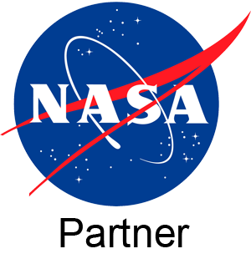
Off the Hook: Assessing the Vulnerability of Inland Subsistence Fisheries to Climate Change
NAU/NASA Space Grant & Conservation International
Caitlin Brogan
B.S. Environmental and Sustainability Studies
Dr. Denielle Perry, NAU Free-Flowing Rivers Lab
Dr. Ian Harrison, Conservation International; NAU
Dr. Abigail Lynch, USGS Climate Adaptation Science Center

Slide 2
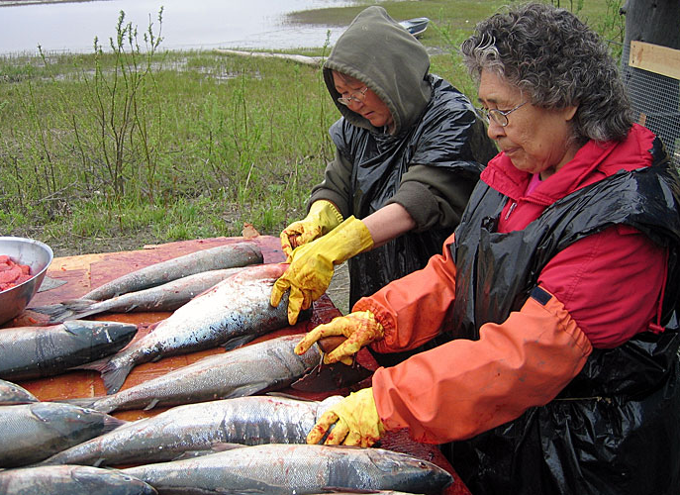
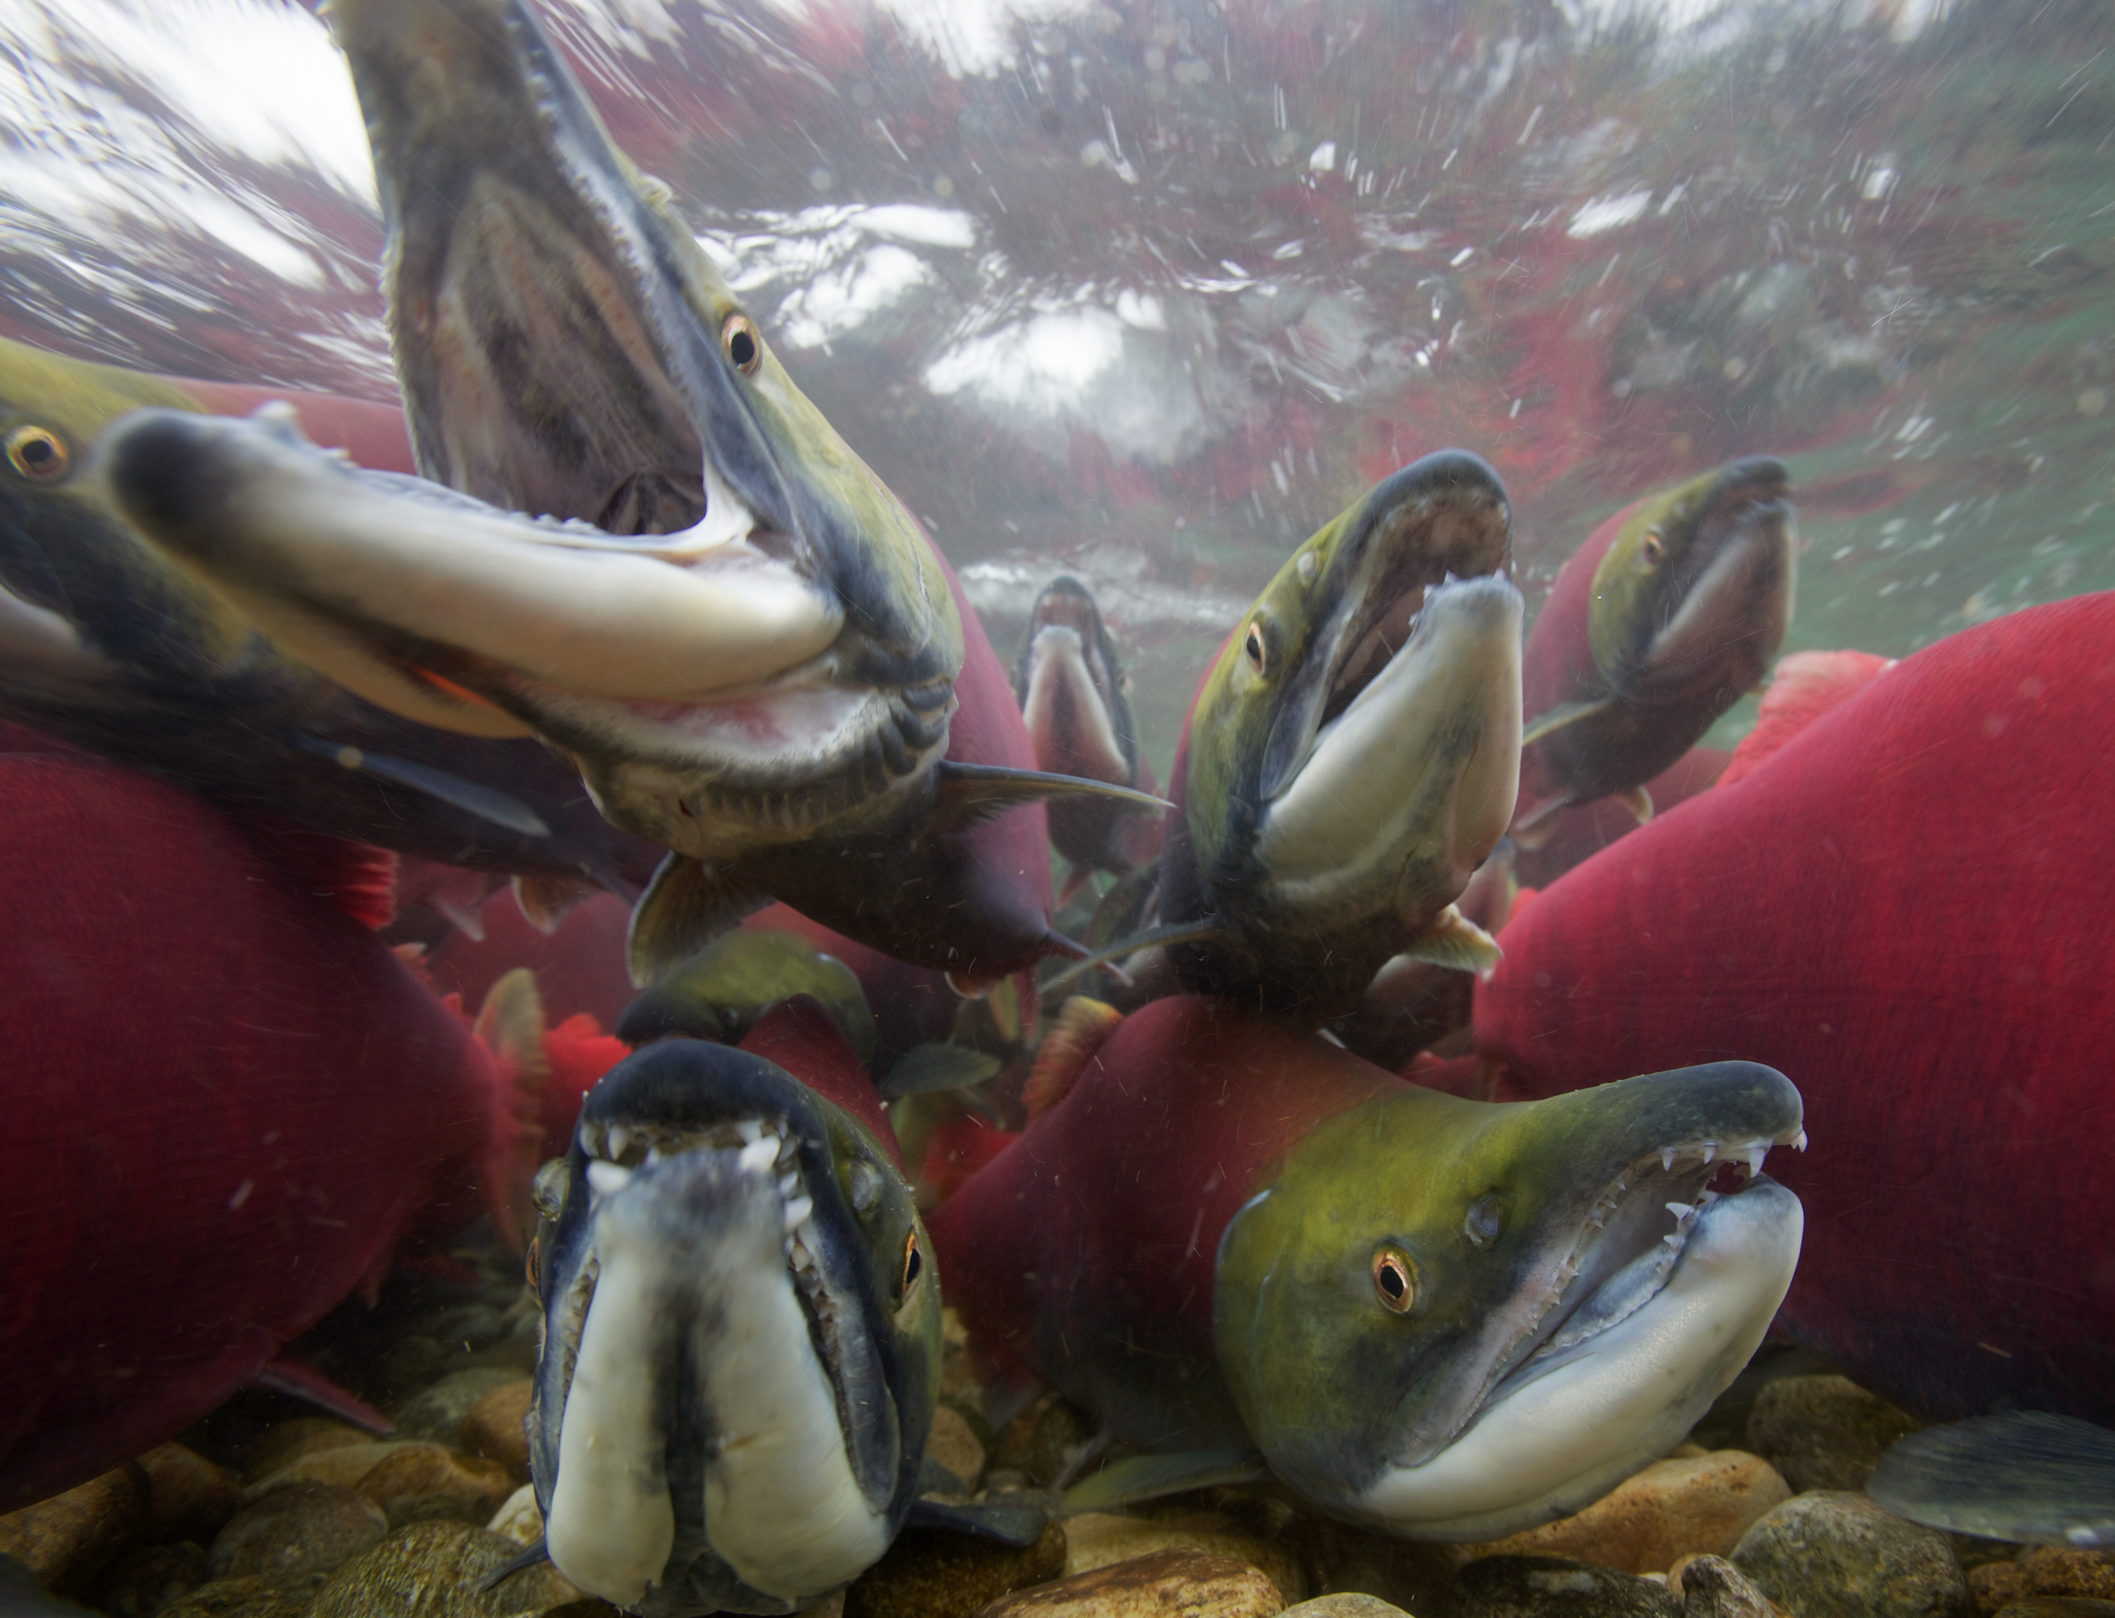
Background & Significance
What is subsistence fishing?
In many communities, inland fisheries are integral to culture
Indigenous and Local Knowledge (ILK) systems
Others may rely on fishing for survival
Inland fisheries are experiencing multi-faceted pressures
Research on inland subsistence fisheries in the U.S. is limited
A way of life is on the line
(via Eye on the Arctic)
(via World’s Forgotten Fishes)
Notes:
FAO Global Report & World’s Forgotten Fishes
“Undervalued, under-reported, and under pressure”

Slide 3
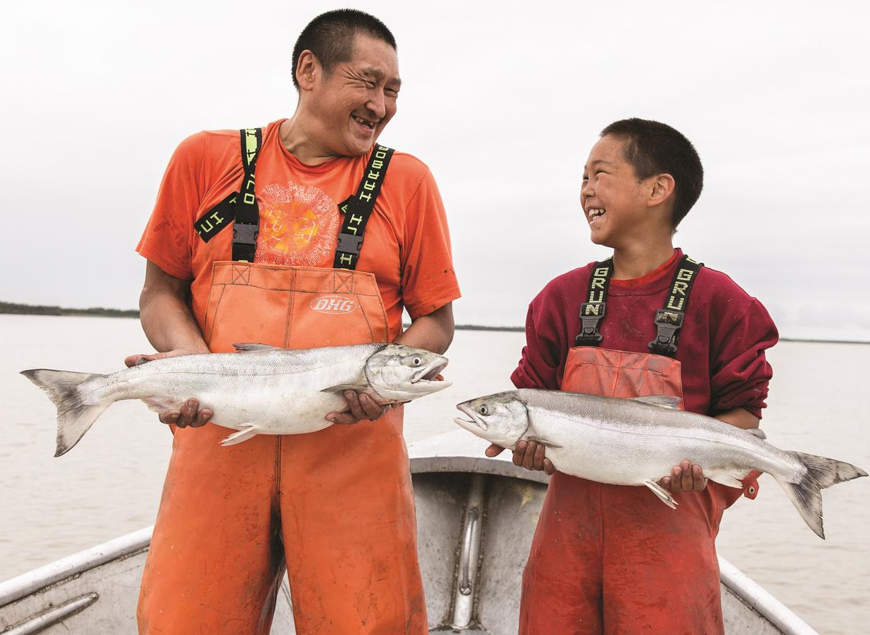
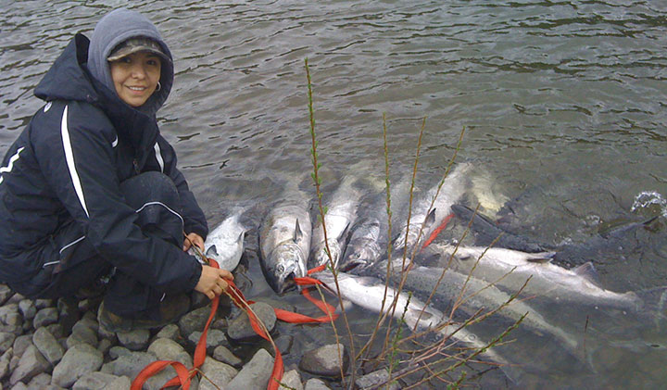
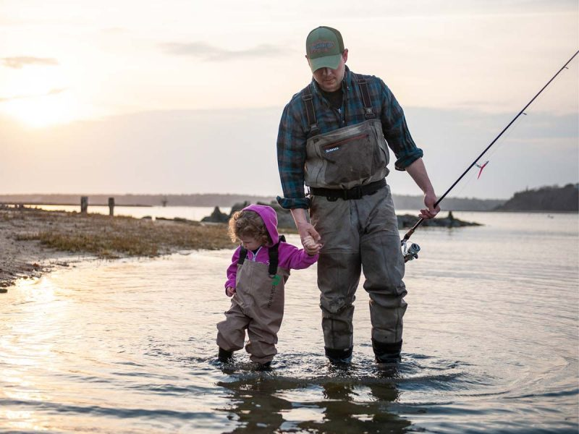
Project Objectives
Identify U.S. communities with high dependence on inland subsistence fisheries
Analyze threats of projected climate change and potential impacts on human communities
Provide policy recommendations for protecting these fisheries and supporting livelihoods
(via Alaska Department of Fish and Game)

Slide 4
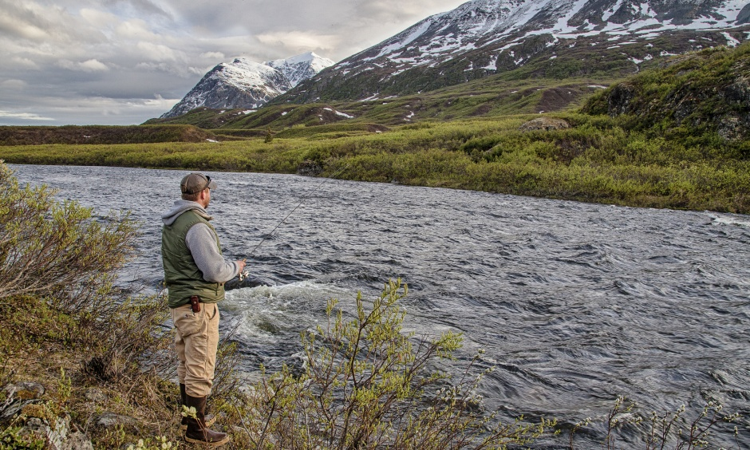
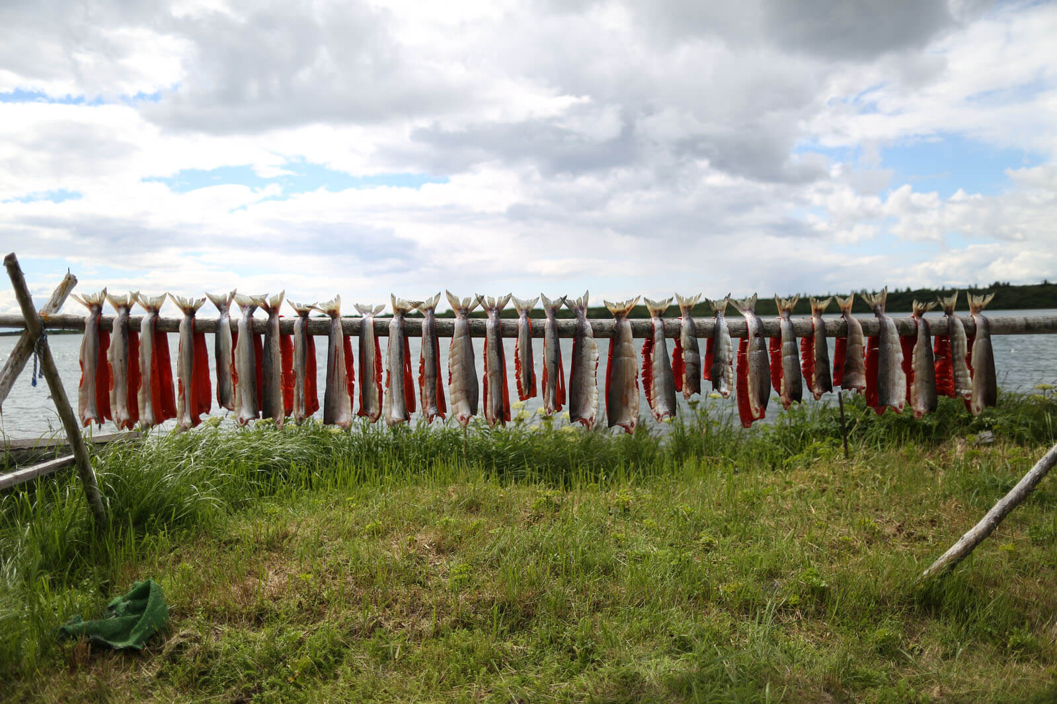
Hypothesis
We hypothesize that areas with:
a cultural or traditional connection to fisheries
lower socioeconomic productivity and employment rate
will have a higher dependence on subsistence fishing activities for food security
(via American Fisheries Society)

Slide 5
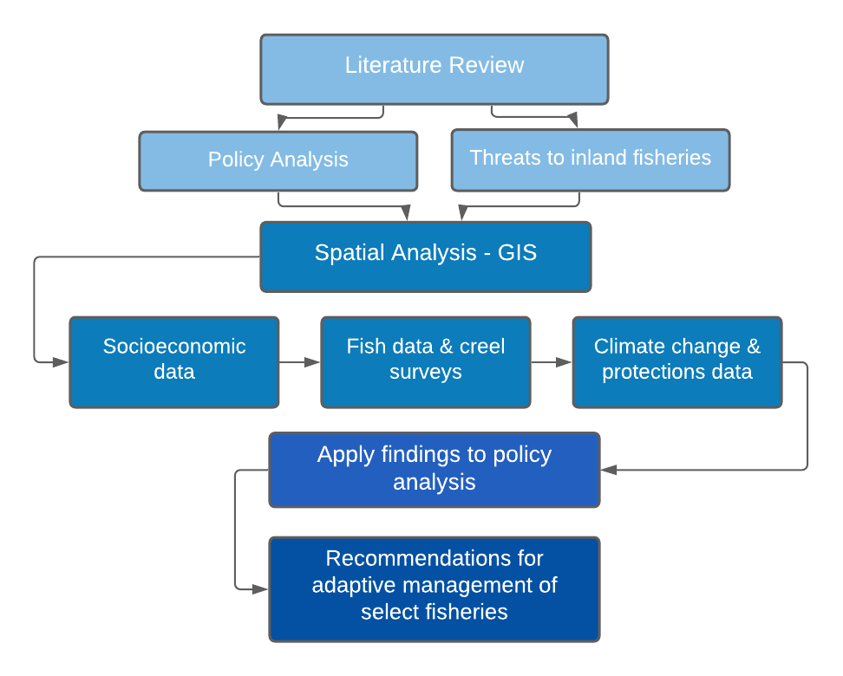
Methodology 3
Notes:
Creel Cat
Harvest patterns
Catch details and motivation
Demographics
Conservation/Management Impacts

Slide 6
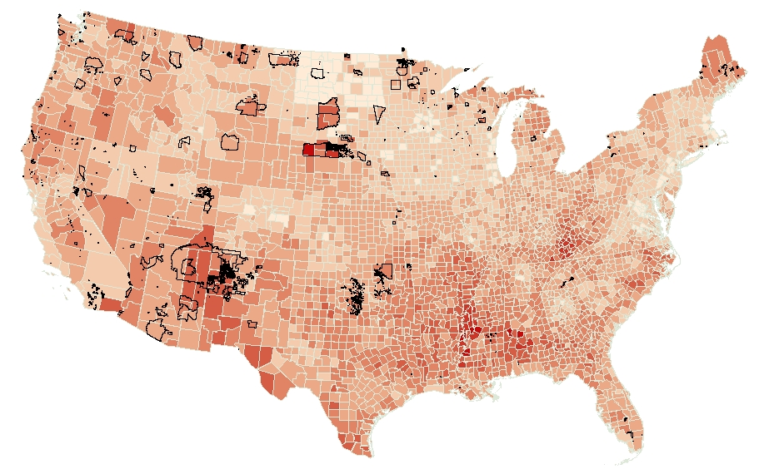
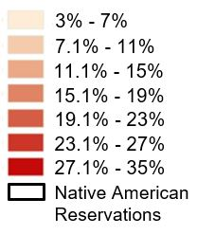
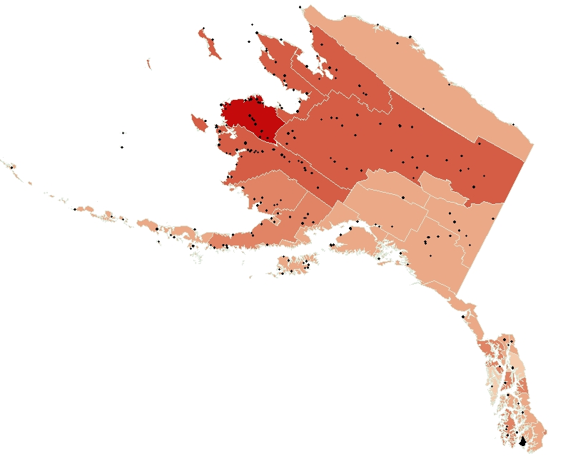
Preliminary Results
Food Insecurity Rate by County in 2018
Alaska Native Villages
Notes:
Using GIS to analyze socio-economic, hydrologic, climate, land use, and creel survey data
Identify the most important areas for protections and potential focal species/watersheds

Slide 7
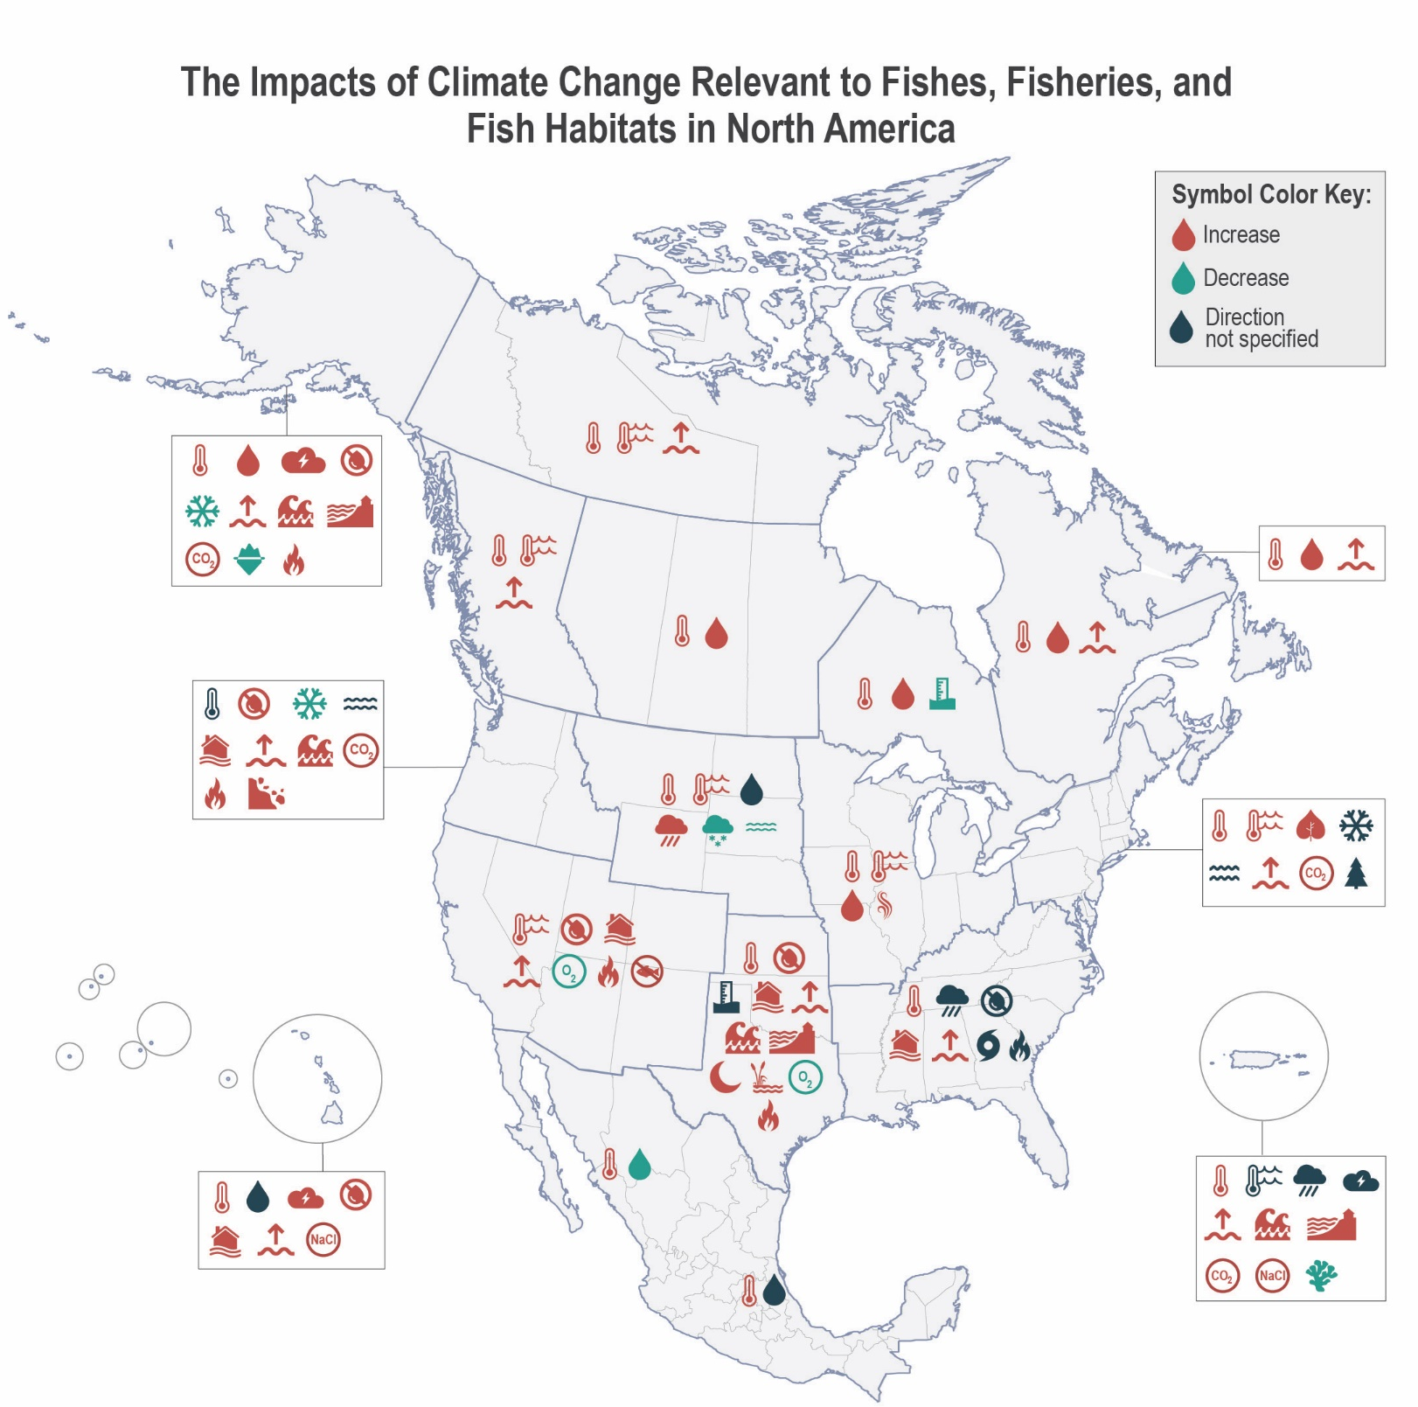

Preliminary Results
(Paukert et al. in Review)

Slide 8
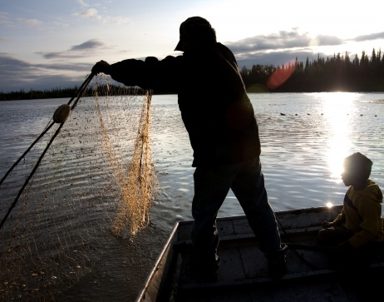
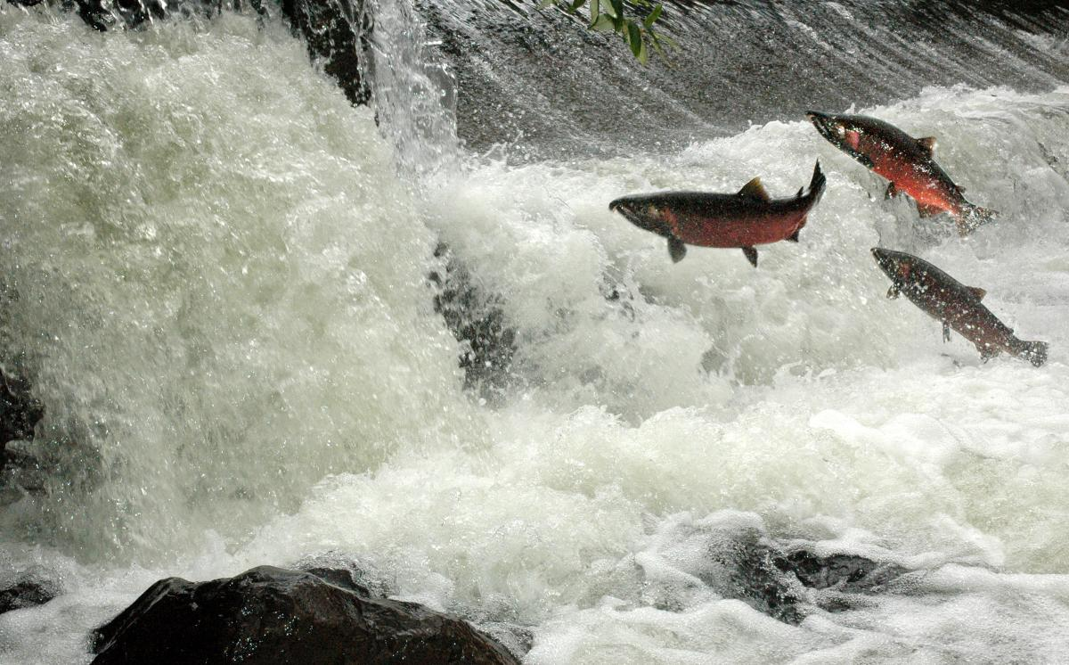
Next Steps
Complete spatial analysis/generate maps & figures
Create a set of recommendations for policymakers and fishery managers
Project will be expanded into graduate research for M.S. in Climate Science and Solutions
(via The Nature Conservancy)

Slide 9
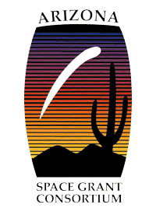
Acknowledgements
Dr. Denielle Perry, Dr. Ian Harrison, and Dr. Abigail Lynch
Paloma Davidson & NAU/NASA Space Grant Program
Conservation International & Arizona Space Grant Consortium
Notes:
Talk about matching funding

Slide 10
Next StepsKey References
Coleman-Jensen, A., Rabbitt, M.P., Gregory, C., & Singh, A. (2020). Household Food Security in the United States in 2019, ERR-275, U.S. Department of Agriculture, Economic Research Service.
Feeding America. (2018). Map the Meal Gap. United States. [Web Archive] Retrieved from the Library of Congress, https://www.loc.gov/item/lcwaN0010877/.
Funge‐Smith, S., & Bennett, A. (2019). A fresh look at inland fisheries and their role in food security and livelihoods. Fish and Fisheries, 20(6), 1176–1195. https://doi.org/10.1111/faf.12403
Jones, R., Travers, C., Rodgers, C., Lazar, B., English, E., Lipton, J., Vogel, J., Strzepek, K., & Martinich, J. (2013). Climate change impacts on freshwater recreational fishing in the United States. Mitigation and Adaptation Strategies for Global Change. https://doi.org/10.1007/s11027-012-9385-3
Nguyen, V. M., Lynch, A. J., Young, N., Cowx, I. G., Beard, T. D., Taylor, W. W., & Cooke, S. J. (2016). To manage inland fisheries is to manage at the social-ecological watershed scale. In Journal of Environmental Management (Vol. 181, pp. 312–325). Academic Press. https://doi.org/10.1016/j.jenvman.2016.06.045
Paukert, C. P., Lynch, A. J., Beard, T. D., Chen, Y., Cooke, S. J., Cooperman, M. S., Cowx, I. G., Ibengwe, L., Infante, D. M., Myers, B. J. E., Nguyễn, H. P., & Winfield, I. J. (2017). Designing a global assessment of climate change on inland fishes and fisheries: knowns and needs. Reviews in Fish Biology and Fisheries, 27(2), 393–409. https://doi.org/10.1007/s11160-017-9477-y
Paukert, C. P., J. D. Olden, A. J. Lynch, D. Brashears, R. C. Chambers, C. Chu, M. Daly, K. L. Dibble, J. A. Falke, D. Issak, P. Jacobson, O. P. Jensen, D. Munroe. In review. Climate Change Effects on North American Fish and Fisheries: A Summary of the Science and Moving Forward with Adaptation. Fisheries.
Forgotten fishes – FAO global report state of fisheries
Subsistence fishing
List key refs from paper

Slide 11
Thank you

